Slide 1
Outline of English Syntax

Slide 2
Word/Lexical Categories
Four ‘main’ classes of words:
  Nouns: refer to objects, concepts etc. (e.g. “birds”)
  Verbs: express action in the sentence (e.g. “sing”)
  Adjectives: describe properties of nouns (e.g. “yellow”)
  Adverbs: modify verbs (e.g. “slowly”)
Other classes
  pronouns, prepositions, determiners, particles, conjunctions etc.
John ate the cake with a spoon
N V Det N Prep Det N

Slide 3
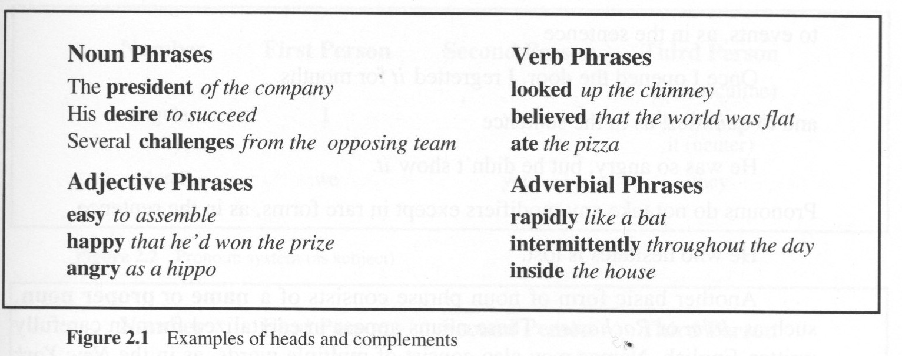
Syntactic Phrases
A phrase is composed of several (but >= 1) words.
The head of a phrase indicates the syntactic type of the phrase.
  Noun phrase, Verb phrase, Adjective phrase, Adverbial phrase
  Other words in a phrase which complete the meaning of the head word are called complements.

Slide 4
Noun Phrases (1)
Noun Phases (NPs) refer to things: objects, places, concepts, events, qualities, etc.
The simplest NP consists of:
  a single pronoun – “he”, “she”, “it”, “they”, “them” etc.
  a name or proper noun – “John”, “Chicago”
  a compound noun (made of > 1 word) denoting a proper noun – “New York”
Excluding pronouns and proper names, the head of a noun phrase is usually a common noun… and usually the right-most one in a compound noun in English
  “cakes”, “the cake”
  “a large chocolate cake”
  “Harry Potter book reviews”
”

Slide 5
Noun Phrases (2)
In addition to a head, A noun phrase may contain:
  specifiers – ordinals (e.g. “first”, “second”), cardinals (e.g. “one”, “two”), and determiners.
  qualifiers – adjectives (e.g., “angry”), noun modifiers.
A simple noun phrase may have at most one determiner, one ordinal, and one cardinal.
  e.g. “the first three contestants”

Slide 6
Inflectional Forms of English Nouns
Number – singular, plural
Tense – present, past, future
Gender – masculine, feminine, neuter (hero, heroine) (tiger, tigress) (hunter, huntress)
Case – nominative (subject), accusative (object), genitive (possessive)

Slide 7
Cases in Malayalam examples
രാമൻ സീതയെ കണ്ടു. (Nominative)
രാജു രാമനെ കണ്ടു. (Accusative)
രാജു രാമന് പേന കൊടുത്തു. (Dative)
രാജു രാമനാൽ കൊല്ലപ്പെട്ടു. (Instrumental)
രാമന്റെ വീട്ടിൽ പോയി. (Genitive)

Slide 8
Grammatical cases of English Nouns
In grammar, the case of a noun or pronoun indicates its grammatical function in a greater phrase or clause; such as the role of subject, of direct object, or of possessor.
Nominative -- subjective case, indicates the subject of a finite verb:
  We went to the store.
Accusative -- objective case, indicates the direct object of a verb:
  The clerk remembered us.
Dative -- indicates the indirect object of a verb:
  The clerk gave us a discount.
Genitive -- possessive case, indicates the possessor of another noun:
  John's book was on the table.

Slide 9
Verb Phrases (1)
Verb Phrases (VPs) describe an action, event or state.
A simple VP may consist of some adverbial modifiers followed by the head verb and its complements.
Every verb must appear in one of the five possible forms:

Slide 10
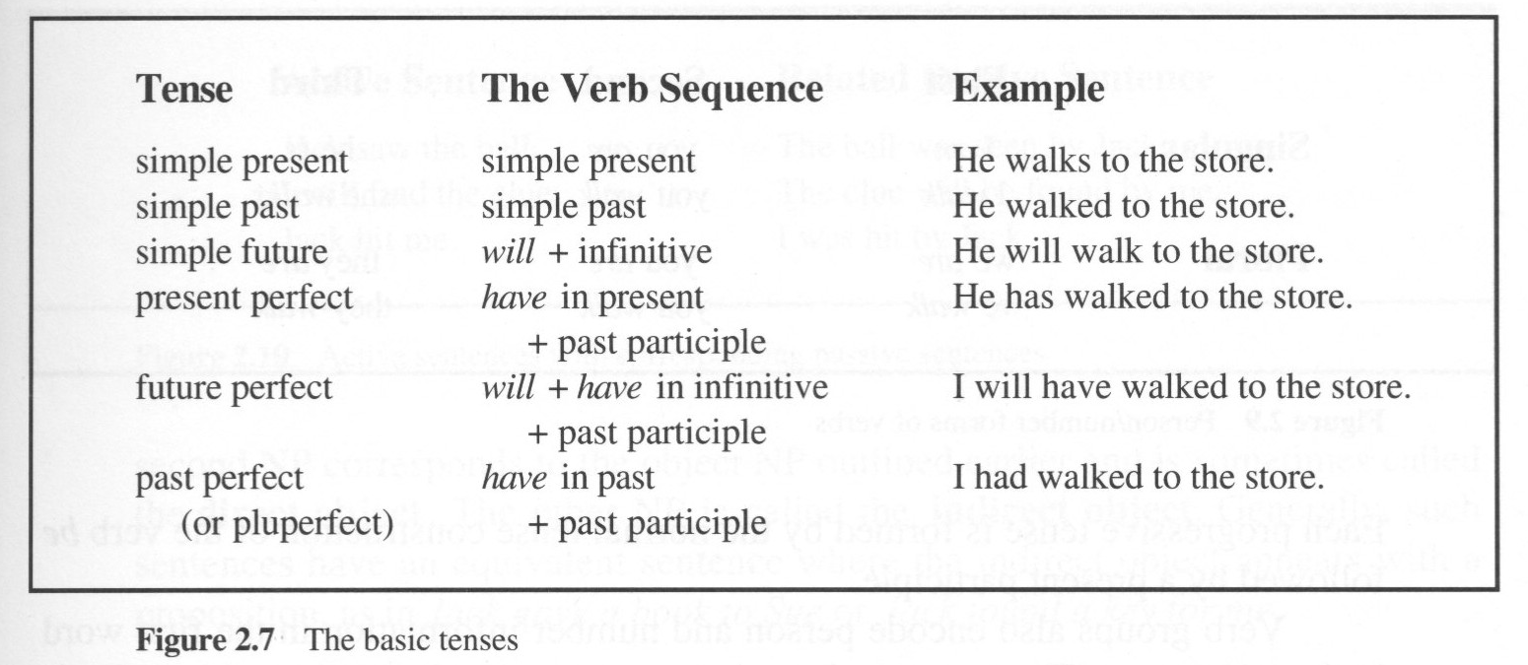
Verb Phrases (2)
Classes of verbs:
  Auxiliary verbs – “be”, “do”, “have”
  Modal verbs – “can”, “will”, “shall”, “must” etc.
  Main verbs – e.g. “cry”, “hit”
The tense (of a sentence) – identifies when the proposition was true.

Slide 11
Transitivity of Verbs
Transitivity of a verb refers to the number of object noun phrases it can take.
  Intransitive – no object NP. e.g. “laugh”
    “She laughed.”
    (*) “She laughed me.” – (*) represents ungrammatical
    “She laughed at me.” – “at me” is not a noun phrase
  Transitive – one object NP. e.g. “write”
    (*) “She wrote.” – must say what she wrote
    “She wrote a book.”
  Ditransitive – two object NPs. e.g. “give”
    “She gave me the book.”
    Ditransitive sentences can be re-written by transitive sentences.
    “She gave the book to me.”

Slide 12
Prepositional Phrase Complements
Many verbs require complements that involve a specific prepositional phrase (PP). e.g.
  “give” takes an NP and a PP with “to”:
    Jack gave the book to Mary.
    (*) Jack gave the book from Mary.
  “put” takes a PP that describes a location:
    Jack put the book on the desk.
    Jack put the book there.
    (*) Jack put the book with a knife.
A sentence with multiple PPs are often ambiguous (so-called “PP attachment problem”)
  I saw a man on the hill with a telescope.

Slide 13
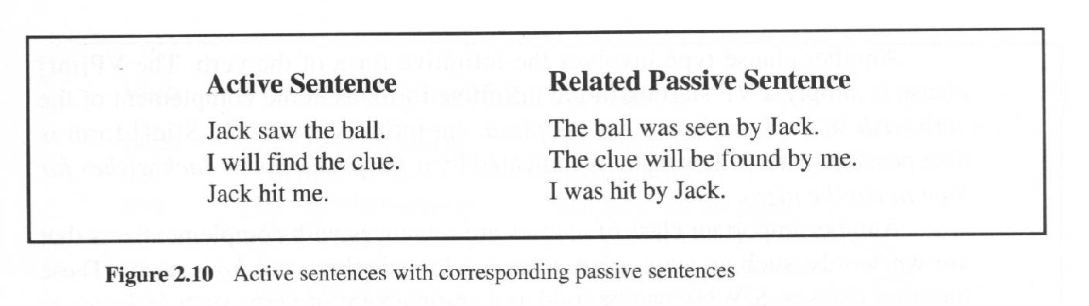
Active vs. Passive Sentences
An active sentence with a transitive/ditransitive verb can be re-written by a passive sentence.

